Slide 1
Emotion Detection in Dialogues
Xiangjue DONG, Yanan DA, Yibo WANG
Notes:
Good afternoon. My name is Yibo, this is Xiangjue, this is Yanan.
Today, we'd like to talk about our final project, emotion detection in dialogues.

Slide 2
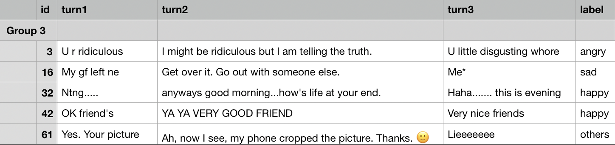
Dataset
Notes:
Each dialogue in our dataset is separated into three turns and labelled as one of the four classes: angry, sad, happy, or other.

Slide 3
Dataset
Continuous tense
Abbreviation
Uppercase
Emojis
Past tense
Notes:
Before building models, we have to clean our dataset. Things like abbreviations, past tense, continuous tense, emojis, uppercase should be dealt with, to make them more readable.

Slide 4
Preprocessing
Uppercase
Abbreviation
Emoji
Lemmatization
Stop words
Punctuation
Old fashion emoticon

Slide 5
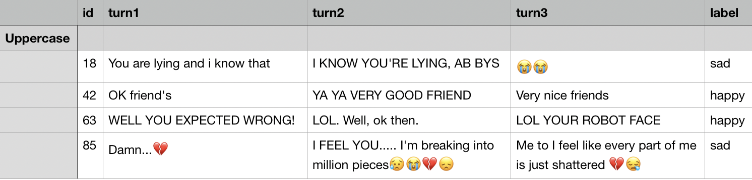
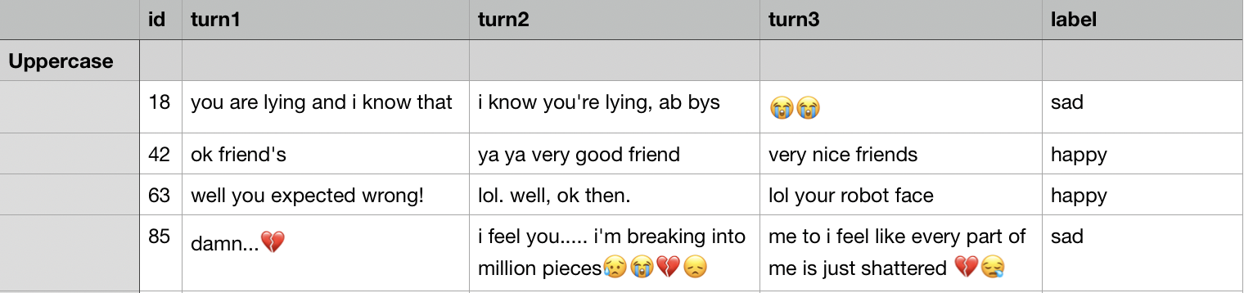
Preprocessing
Notes:
Here are some examples.
On the top is the original dataset, and the other one is dataset after preprocessing.
First, we set our dataset content to lowercase, to make it easier to preprocess.

Slide 6
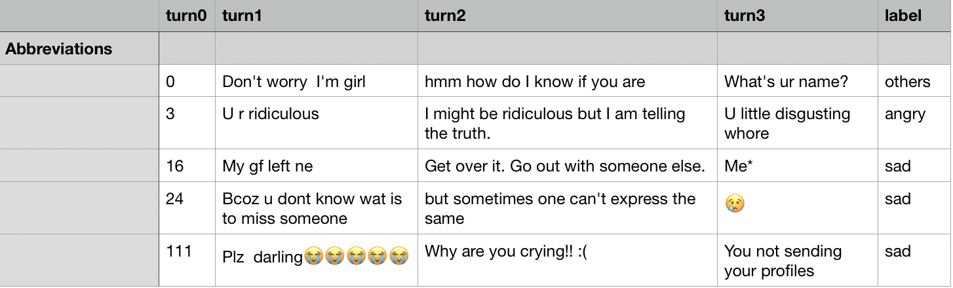
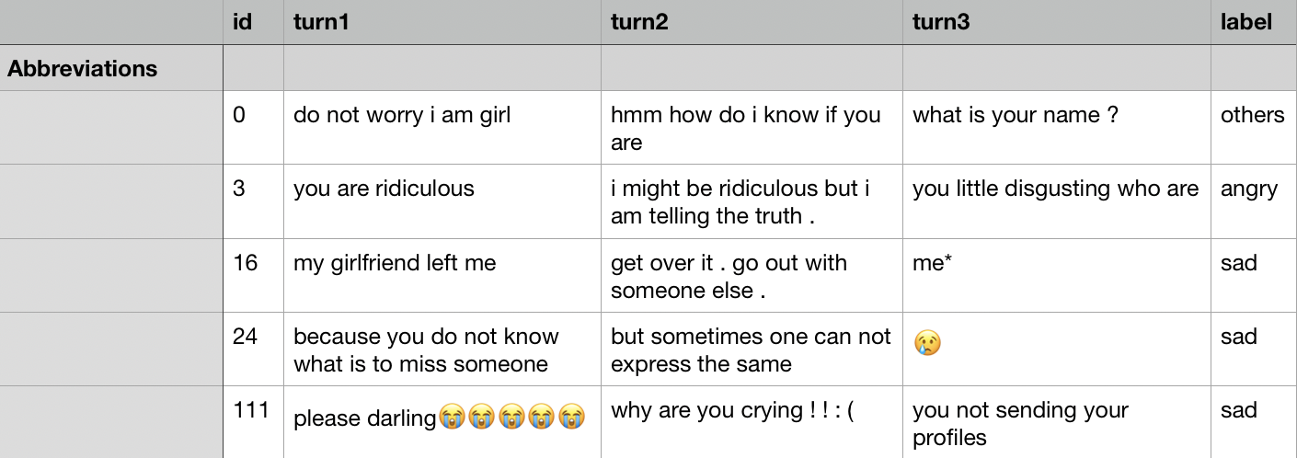
Preprocessing
Notes:
Then we built a dictionary to expand general abbreviations, like 'don’t' to 'do not', 'u' to 'you', 'gf' to 'girlfriend', 'bcoz' to 'because', 'plz' to 'please', and so on.

Slide 7
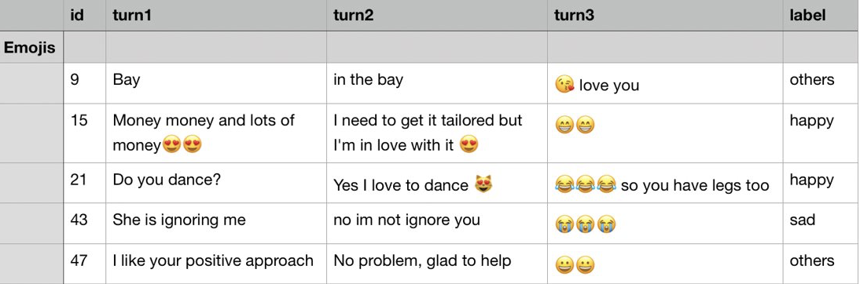
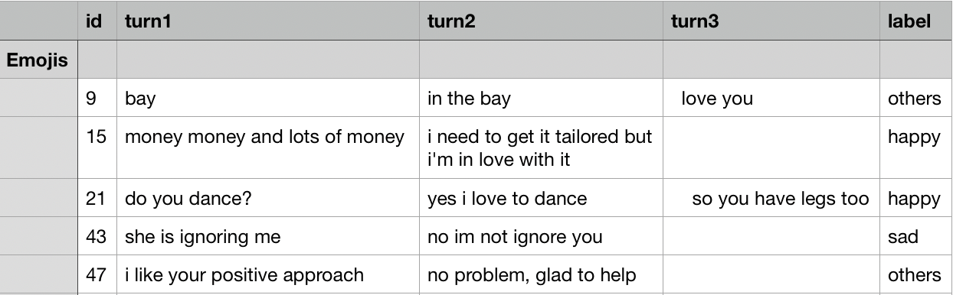
Preprocessing
Notes:
And we deleted emojis

Slide 8
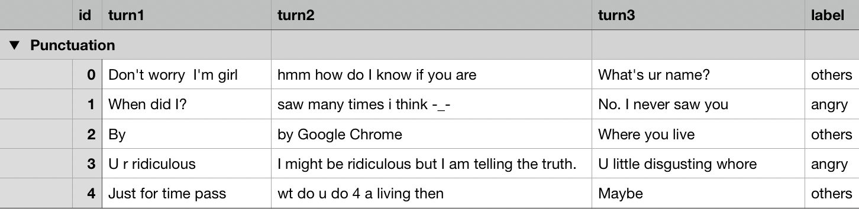
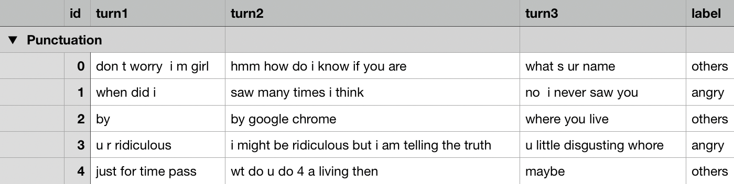
Preprocessing
Notes:
and replaced punctuations with blank space. Because they will influence our feature selection.

Slide 9
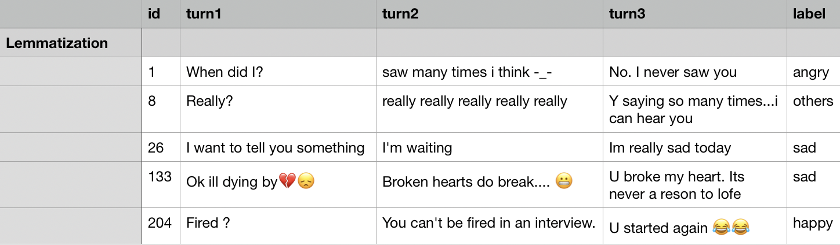
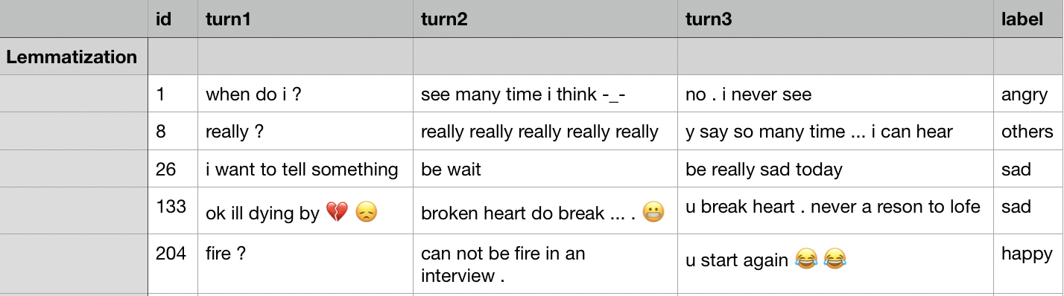
Preprocessing
Notes:
Another problem is different tenses. So we use lemmatization to deal with it. We use three python tools: word net lemmatizer, textblob, spacy, to make sure the performance is good. As shown here, lemmatization changed 'did' to 'do', 'saying' to 'say', 'I'm' to 'pronominal be' and then I deleted all these pronominal.

Slide 10
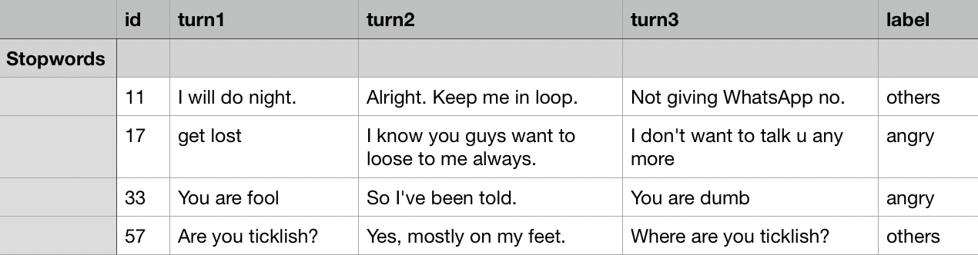
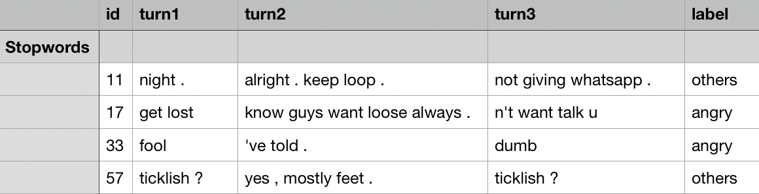
Preprocessing
Notes:
Next was to delete stop words. Stop words are the most common words in a language. We used the common english stop words, but removed some negative words, like 'not'.

Slide 11
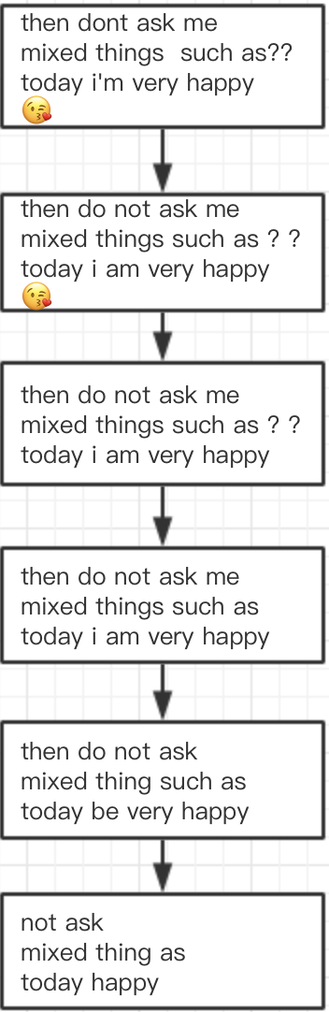
Preprocessing: Cleaned Dataset 1
Uppercase
Abbreviation
Emoji
Punctuation
Lemmatization
Stop words
Notes:
The order of preprocessing is also important, because some processes will influence each other. For example, if we lemmatize before expanding abbreviations, there will be some mistakes or omissions.
So we combined these processes in a reasonable order, and built two cleaned dataset. Here are the steps, and the outcome of each step.
In the first cleaned dataset, we deleted stop words;

Slide 12
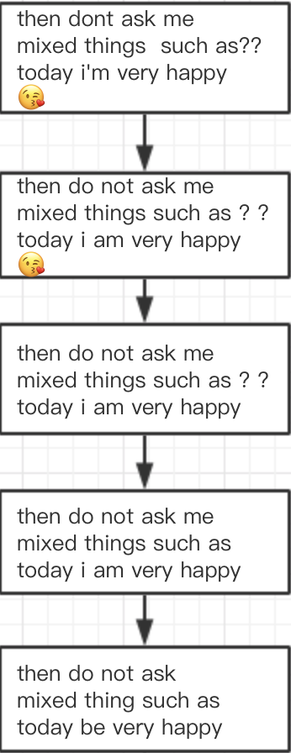
Preprocessing: Cleaned Dataset 2
Uppercase
Abbreviation
Emoji
Punctuation
Lemmatization
Notes:
While in the second cleaned dataset we kept those stop words. Because we are not sure whether these stop words will influence the result or not. So we want to make a comparison.

Slide 13
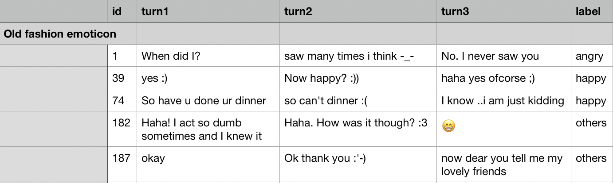
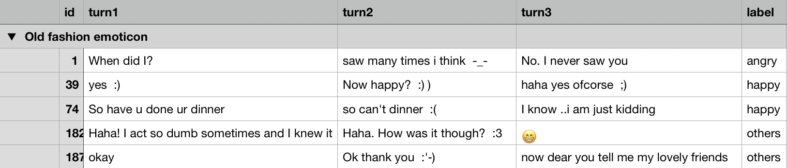
Preprocessing: Cleaned Dataset 3
Notes:
However, uppercase, some punctuations and emojis are meaningful, because uppercase and exclamation marks can express very strong emotions and emojis can also express emotions. When we select features, we should take them into account.
So we built another dataset. In this dataset, we kept uppercase, punctuations and emojis, and only processed old fashion emoticons. We added blank space before and after old fashion emoticons to make them be a token. This dataset is only for features like uppercase, punctuations, emojis and old fashion emoticons.
This is what we did for preprocessing dataset.

Slide 14
Feature Extraction
Word Count
Special Characters
Uppercases
Exclamation Marks
Emojis
Emoticons
Unigram
Bigram
Trigram

Slide 15
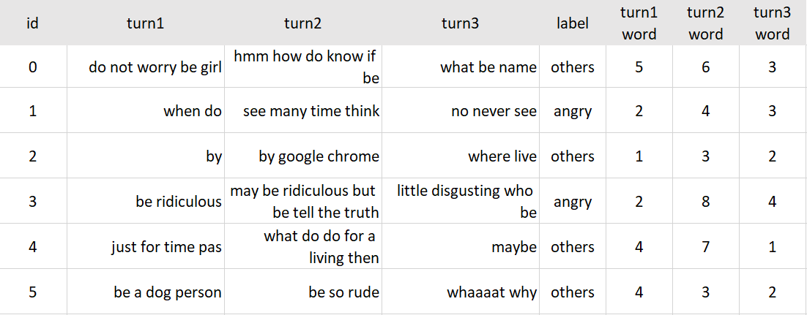
Feature – Word Count
Cleaned text – keep stop words

Slide 16
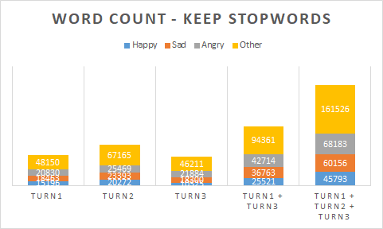
Feature – Word Count

Slide 17
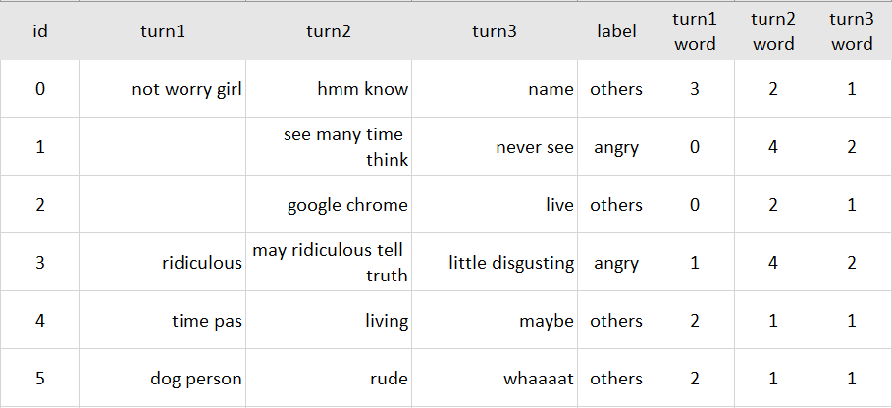
Feature – Word Count
Cleaned text – delete stop words

Slide 18
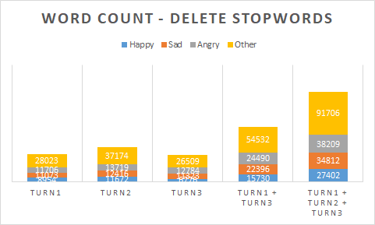
Feature – Word Count

Slide 19
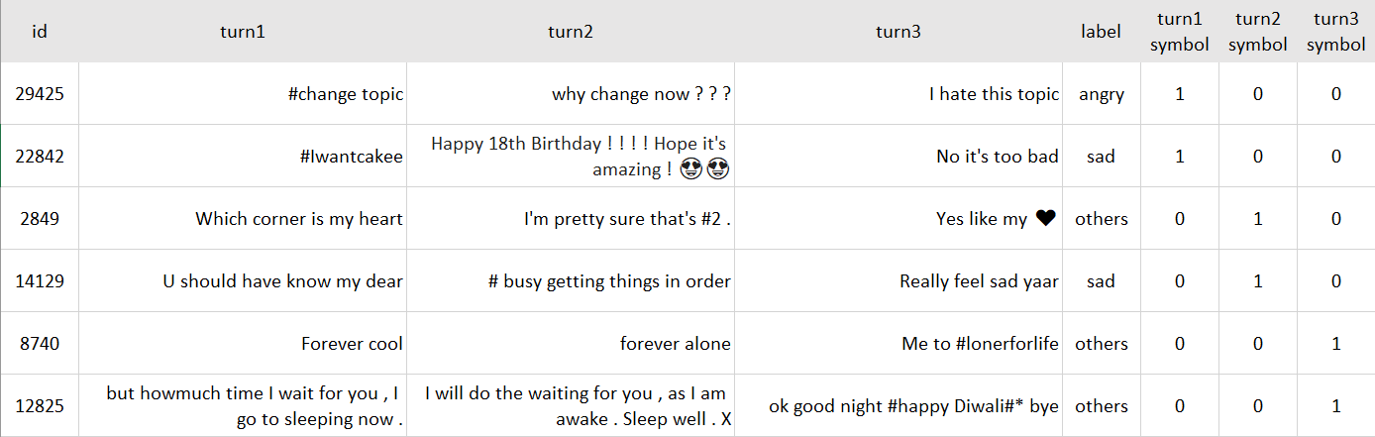
Feature – Special Character #

Slide 20
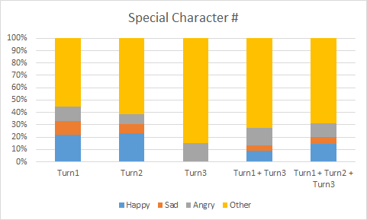
Feature – Special Character #

Slide 21
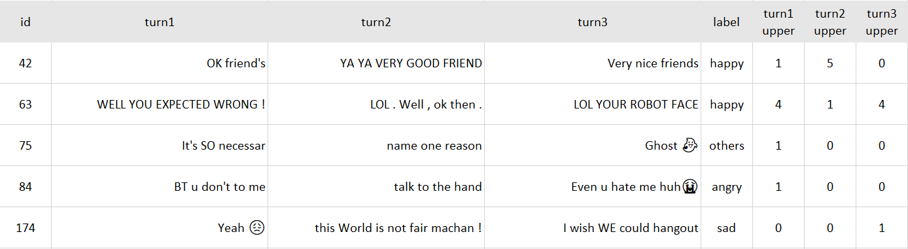
Feature - Uppercases

Slide 22
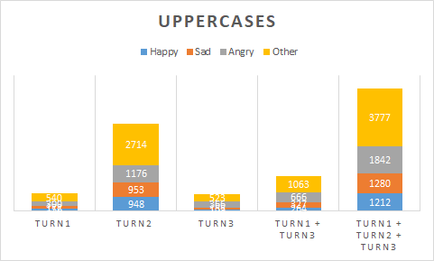
Feature - Uppercases

Slide 23
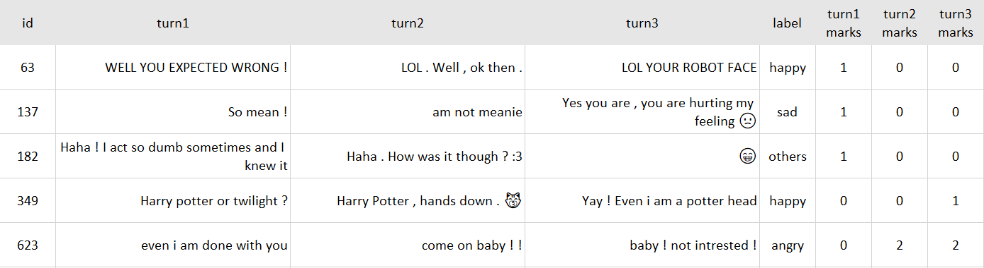
Feature - Exclamation Marks

Slide 24
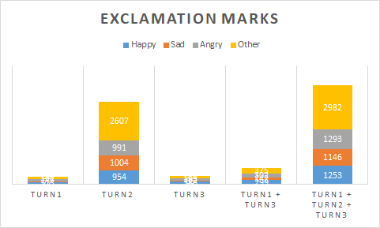
Feature - Exclamation Marks

Slide 25
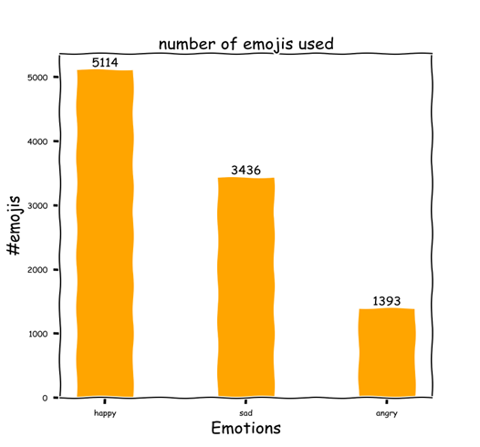
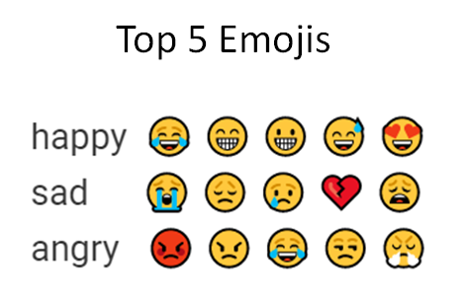
Feature - Emojis

Slide 26
Feature - Emoticons
Emoticon_list = [
':‑)', ':)', ':-]', ':]', ':-3', ':3', ':->', ':>', '8-)', '8)', ':-}', ':}', ':o)', ':c)', ':^)', '=]', '=)',
':‑d', ':d', '8‑d', '8d', 'x‑d', 'xd', 'x‑d', 'xd', '=d', '=3', 'b^d',
':-))',
':‑(', ':(', ':‑c', ':c', ':‑<', ':<', ':‑[', ':[', ':-||', '>:[', ':{', ':@', '>:(',
":'‑(", ":'(",
":'‑)", ":')",
"-_-"
]

Slide 27
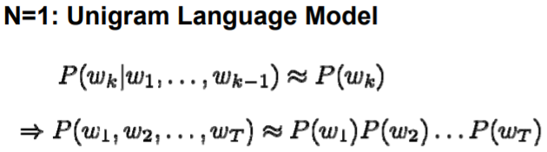
Feature - Unigrams
http://lintool.github.io/UMD-courses/CMSC723-2009-Fall/session9-slides.pdf

Slide 28
Feature - Unigrams
Sentence:
I am telling the truth
Unigrams:
I,
Am,
Telling,
The,
Truth

Slide 29
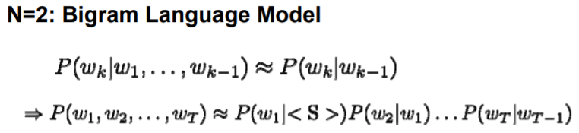
Feature - Bigrams
http://lintool.github.io/UMD-courses/CMSC723-2009-Fall/session9-slides.pdf
Notes:
A bigram or digram is a sequence of two adjacent elements from a string of tokens,
Bigrams help provide the conditional probability of a token given the preceding token

Slide 30
Feature - Bigrams
Sentence:
I am telling the truth
Bigrams:
I am,
Am telling,
Telling the,
The truth

Slide 31
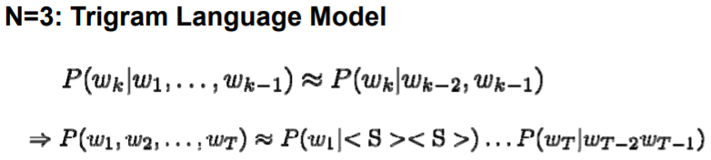
Feature - Trigrams
http://lintool.github.io/UMD-courses/CMSC723-2009-Fall/session9-slides.pdf

Slide 32
Feature - Trigrams
Sentence:
I am telling the truth
Trigrams:
I am telling,
Am telling the,
Telling the truth

Slide 33
Feature – Combination on Turns
Turn1 + Turn3
Turn1 + Turn2 + Turn3

Slide 34
Feature Selection
Feature Selection
Forward step wise
Stop when the loss does not decrease
Emotion | Features
Happy | bigram, emoji, emoticon, word_count, exclamation_mark
Sad | bigram, emoji, emoticon, word_count
Angry | bigram, emoji, uppercase, exclamation_mark
Other | bigram, emoji, emoticon, word_count
All(for baseline) | bigram, emoji, emoticon, word_count

Slide 35
Model
Baseline
SVM multilabel classification
Our Model
SVM
Happy
P(h)
SVM
Sad
P(s)
P(a)
Max(P(h), P(s), P(a), P(o) )
SVM
Angry
P(o)
SVM
Other

Slide 36
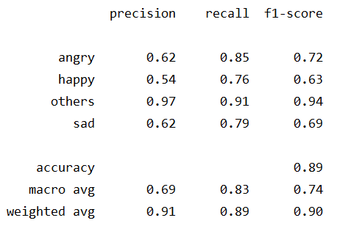
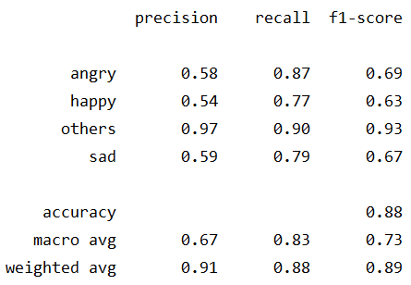
Results
Our Model: Baseline
Notes:
Slightly better

Slide 37
Possibility Adjusting
ratio_class = # labels for the class / total # labels
SVM
Happy
P(h)*ratio_h
SVM
Sad
P(s)*ratio_s
P(a)*ratio_a
Max(P(h), P(s), P(a), P(o) )
SVM
Angry
P(o)*ratio_o
SVM
Other
Notes:
Take class distribution into account

Slide 38

Results
Our Model: Baseline
Notes:
Slightly better

Slide 39
More Work
Keep stop words
Analyze mispredictions

Slide 40
Thank you

Slide 41
Feature - TF-IDF
TF: Term Frequency - how frequently a term occurs in a document.
TF(t, d) = (Number of times term t appears in a document) / (Total number of terms in the document)
IDF: Inverse Document Frequency - how important a term is.
IDF(t, D) = log (Total number of documents / Number of documents with term t in it).
TF-IDF
TF-IDF(t, d, D) = TF(t, d) * IDF(t, D)
https://en.wikipedia.org/wiki/Tf%E2%80%93idf
Notes:
tf–idf or TFIDF, short for term frequency–inverse document frequency, is a numerical statistic that is intended to reflect how important a word is to a document in a collection or corpus
Bigger – More important
The importance increases proportionally to the number of times a word appears in the document but is offset by the frequency of the word in the corpus.
An n-gram model is a type of probabilistic language model for predicting the next item in such a sequence in the form of a (n − 1)–order Markov mode

